Slide 1
The Essentials of Grant and Fellowship Proposal Development
Kenyon College
June 5, 2018

Slide 2
Amy K. Lindner Executive Director, Government, Corporate, and Foundation Relations Utica College
Background in Social Work and Public Administration with a focus on Non-profit Administration
Research Associates – Before and After School Programs in Rural School Districts, Funding Directories, Grants Workshops
Hamilton College – Sponsored Research and Institutional Grants
NSF, NIH, NEH, NIST, DoD, DoEd, EPA, ACLS, Guggenhiem, Fulbright…
Utica College – Sponsored Research and Institutional Grants

Slide 3
Agenda
Morning Session:
Grant Readiness
Getting to know your funding agency
Planning your research project
Working Lunch: Grantsmanship 101 and mock reviews
Afternoon Session:
Writing your proposal
Understanding reviewer comments
Deciding to resubmit

Slide 4
Ground Rules
Stop me at any time.
Please share your experiences.
Grants/Fellowships = anomalies.
Use one to two word processing
documents for all activities/exercises.

Slide 6
Let’s start with the Big Picture

Slide 7
Where are you trying to go?
What’s the Big Picture Question? Why is the Big Picture Question Needed?
What is the Overarching Challenge?
Dissertation Preliminary Work Project One Project Two

Slide 8
Establishing Long-Term Research & Educational Agendas
Articulate your long-term plan.
Position projects are steps along the path.
Build a line of scholarship.
Incorporate that scholarship into your teaching.
Understand that things can and do change…and that’s ok!

Slide 9
Your Research Agenda
What big questions do you want to answer in the first 5 years? In the first 15 years?
Is your agenda in an exciting, high-impact area of scholarship?
Is the topic separated enough from that of your advisor to establish an independent career, but builds on your grad work?
Is it a topic you are passionate about?
Do you have publications that will support this line of research?
Is your topic in an area that is currently funded by agencies or likely to be funded soon?

Slide 10
Your Education Agenda
How do you want to improve education in your institution and in your discipline?
What are the latest ideas for improving education in your discipline?
What are the educational priorities of your institution? How does your agenda fit into those priorities?
Are there needs for outreach that you would like to address?

Slide 11
10 Minute Exercise
In five minutes: Describe your long-term research agenda
In five minutes: Describe your education agenda

Slide 12
Getting Ready for Grants and Fellowships: Becoming More Competitive Before You Write
Do not work in isolation – Identify colleagues and mentors
(HINT: Look around the room!)

Slide 13
Getting Ready for Grants and Fellowships: Becoming More Competitive Before You Write
NETWORK
Seek the counsel of colleagues and mentors who have received funding.
Ask these people to listen to your elevator speech and provide an honest reaction.
Ask these people to read drafts of your narrative.
Attend conferences and seek out program directors from agencies, colleagues in their area who have been well-funded.
Determine where they expect to seek funding and work to become part of that community.
Volunteer to be a reviewer.

Slide 14
Getting Ready for Grants and Fellowships: Becoming More Competitive Before You Write
ESTABLISH A TRACK RECORD
Publish on the topic.
Pursue smaller grants first.
Consider collaborating with funded researchers.
Generate preliminary results.

Slide 15
Getting Ready for Grants and Fellowships: Becoming More Competitive Before You Write
BE STRATEGIC
Use your time wisely.
Outline grant submissions for the first ~5 years as part of your overall career plan.
Understand expectations in your field, institution, and department.
Get to know your agency(ies) and programs.
Work to position yourself to be competitive (publications, preliminary data).
Allow enough time to prepare a well-written proposal.
Learn the process at your institution!!!

Slide 16
Getting Ready for Grants and Fellowships: Becoming More Competitive Before You Write
Mental Preparedness
Plan on rejection:
Funding rates typically 20% or lower.
Even the best researchers are declined more than they are funded.
Agencies expect you to revise and resubmit.
Learn from declined proposals.
Each proposal will get better.

Slide 17
Planning to Write
Choose your project idea
Identify likely funders
Identify and analyze the appropriate program(s)/funding opportunity
Translate your idea into a project that fits the funding opportunity
Talk to your program officer(s) about your project
Plan how you will address other requirements (i.e., dissemination, assessment/evaluation, student training, etc)
Recruit any needed collaborators
Talk to your pre-award office
Line up colleagues and others to read your drafts
Schedule your proposal writing time

Slide 18
Getting to Know your Funding Agency
From where do they get their funds?
What is the mission of the organization?
What is the structure of the organization?
Who staffs the organization?
Who reviews the proposals?

Slide 19
Getting to Know your Funding Agency
Federal: Basic Research vs. Mission-Centric Agencies
Basic Research Funding Agencies:
Agencies with broad or general goals.
Goals are relatively stable over time.
Funding is less subject to political changes.
Mission-Centric Agencies:
Research foci can change rapidly.
Goal can and do change due to political climate.
Funding is less stable and shifts due to political climate.

Slide 20
Getting to Know your Funding Agency
Foundations
Can be large and similar to federal agencies.
Can be small and quirky.
Tend to have very focused priorities, but those priorities can and do change depending on the CEO or Board.
Often relies on program officer review only.
Do your homework:
Carefully read their website.
What and who has been funded?
Track down the 990 on the Foundation Center or Guidestar website.
Try to talk to the Program Officer.

Slide 21
Getting to Know your Funding Agency
Professional Societies/Associations
Typically smaller amounts of money.
Focused on advancing the discipline.
Often provide developmental grants (Dissertation fellowships, early career fellowships, etc.).
Examples: American Council of Learned Societies, American Chemical Society, American Association of University Women.

Slide 22
Getting to Know your Funding Agency
Museums, Collections, Libraries
Provide funding to use their collections
Fellowships
Travel grants

Slide 23
10 Minute Exercise
Find your program using the funder’s website.
Identify your program officer/director(s).
When is the proposal due? How are you to submit the proposal?
Are there budgetary limitations? If yes, what are they? For how long are the awards made?
Can you figure out who will be reviewing your proposal (internal reviewer vs external reviewer)?
Check the awards database: what projects have been funded in recent years? For how much? Did you find any projects similar to yours? If yes, identify how your project is different.

Slide 24
Review Criteria
Every program has criteria which are used to evaluate the proposal.
Some programs are very explicit, while others are less so.
Successful proposals speak to both the mission and goals of the funding agency as well as the program-specific review criteria.

Slide 25
Review Criteria
Most important part of solicitation!
Plan how you will meet each review criteria.
Structure your proposal outline to reflect review criteria.
If you are weak in an area, plan how you will address your weaknesses.

Slide 26
Review Criteria: Unspoken Expectations
Qualifications and experience of PI(s):
Why are you the right person to complete this project?
Composition of your research team: who adds what to the project?
How does this fit into your research and educational agendas?
Infrastructure provided by PI’s institution:
Are you provided the time to carry out the project?
Do you have the facilities and resources at your disposal to complete the project?
If applicable: How does this fit the educational priorities of the institution?
Preliminary data.
Evidence of success or ability to complete projects.

Slide 27
Review Criteria: Example NEH Mission
Because democracy demands wisdom, NEH serves and strengthens our republic by promoting excellence in the humanities and conveying the lessons of history to all Americans. The Endowment accomplishes this mission by awarding grants for top-rated proposals examined by panels of independent, external reviewers.

Slide 28
Review Criteria: Example NEH – “What we do.”
BRING THE HUMANITIES TO ALL AMERICANS.
PRESERVE OUR FOUNDING DOCUMENTS.
PROMOTE AMERICAN HISTORY.
SPARK INNOVATION AND RESEARCH.
STRENGTHEN LOCAL COMMUNITIES.
FOSTER BETTER TEACHING.
LEVERAGE PRIVATE GIVING.
STIMULATE LOCAL ECONOMIES.
DISCOVER IMPORTANT THINGS.
SMALL INVESTMENT FOR LARGE IMPACT.

Slide 29
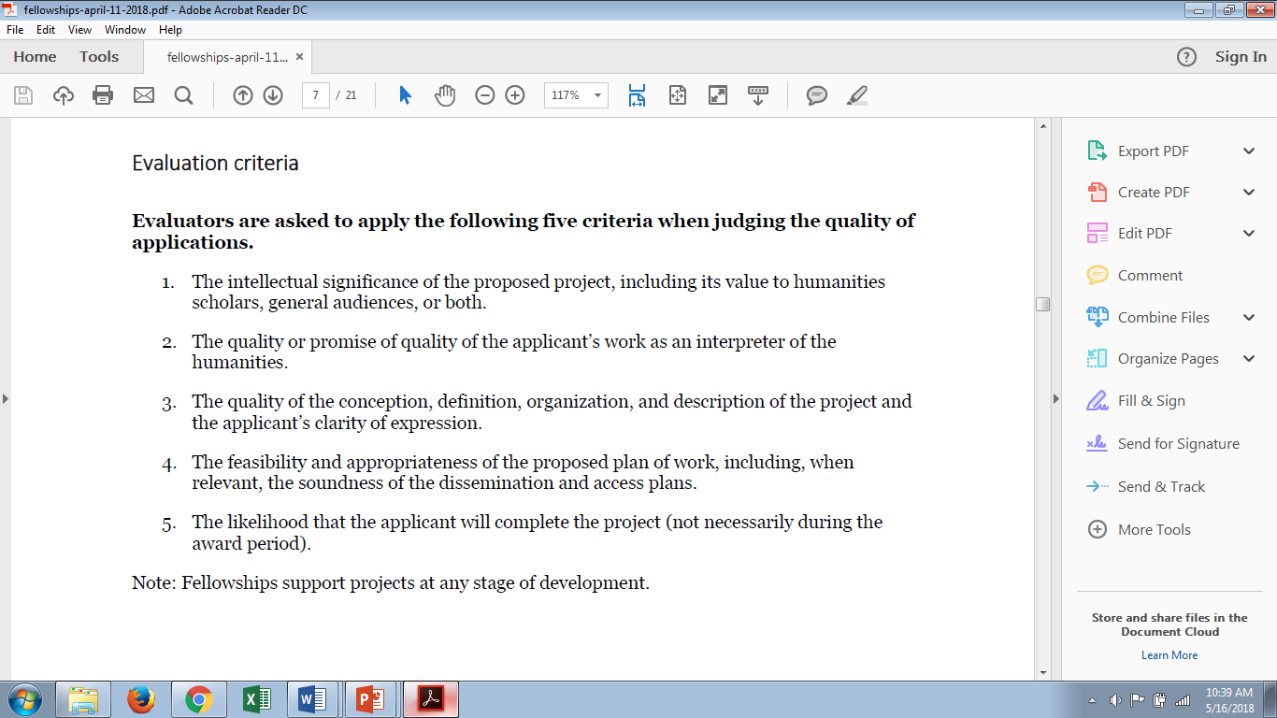
Review Criteria: Example NEH Fellowships (2018)

Slide 30
Review Criteria: Example ACLS Mission
The mission of the American Council of Learned Societies is "the advancement of humanistic studies in all fields of learning in the humanities and the social sciences and the maintenance and strengthening of relations among the national societies devoted to such studies."

Slide 31
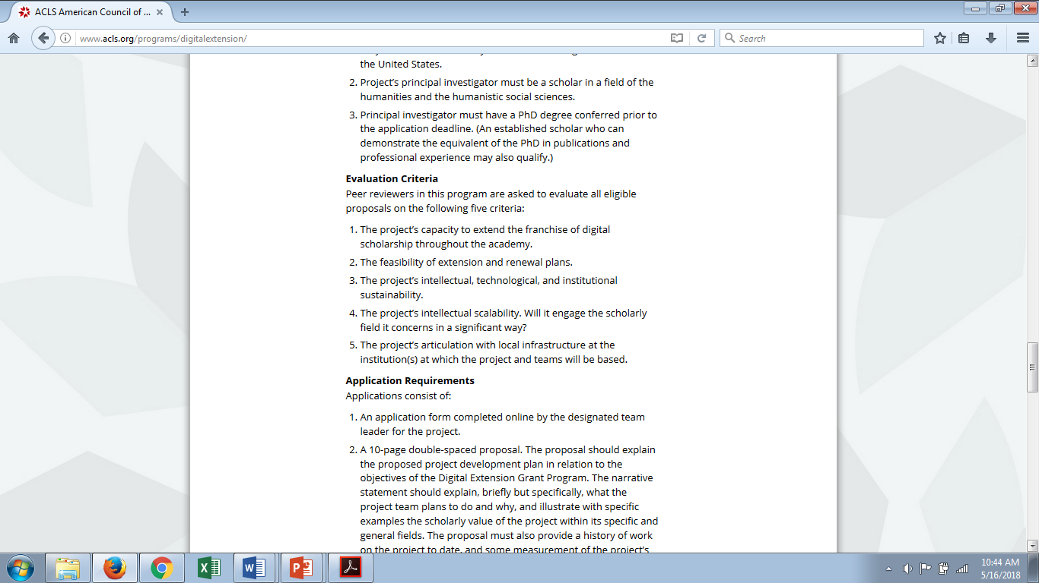
Review Criteria: Example ACLS Digital Extension Grants

Slide 32
Review Criteria: Example Stanford Humanities Center “About Us”
The humanities provide us with tools for understanding our experience as human beings: to discover who we have been and to imagine the possibilities of who we might become. The Stanford Humanities Center is a world-renowned hub for advanced research, inspiring the work of innovative scholars and students at all stages in their academic careers. Each year the Center welcomes nearly 50 fellows and international visitors, hosts over 100 research workshops, and presents over 50 public events as part of an on-going project to investigate some of the most important questions facing humanity today.

Slide 33
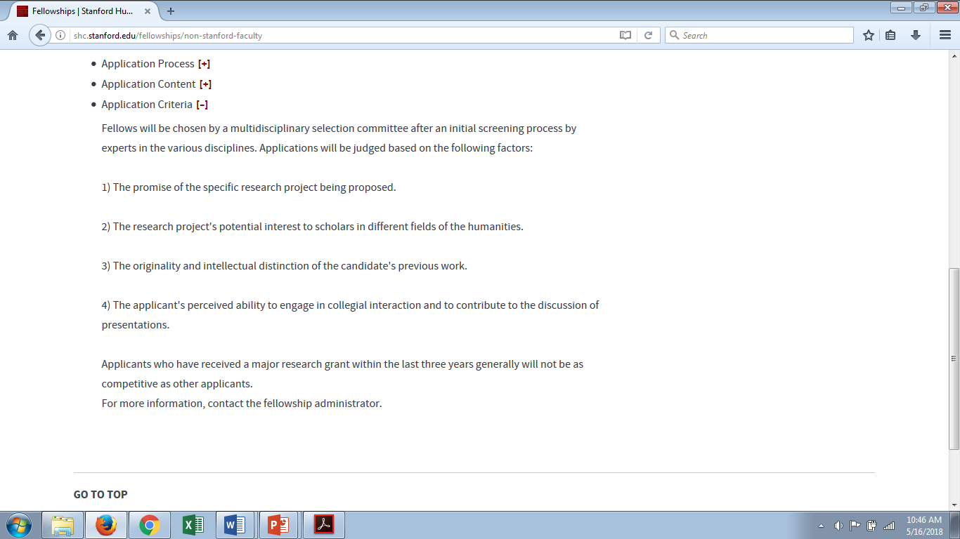
Review Criteria: Example Stanford Humanities Center

Slide 34
10 Minute Exercise
Identify the review criteria for your potential funding opportunity.
Copy and paste them into your working document.
Are there any criteria you don’t understand or don’t know how to meet?
Read between the proverbial lines: What do you think some of the unspoken criteria might be? Write those out.

Slide 35
Planning to write
Choose your project idea
Identify likely funders
Identify and analyze the appropriate program(s)/funding opportunity
Translate your idea into a project that fits the funding opportunity
Talk to your program officer(s) about your project
Plan how you will address other requirements (i.e., dissemination, assessment/evaluation, student training, etc)
Recruit any needed collaborators
Talk to your pre-award office
Line up colleagues and others to read your drafts
Schedule your proposal writing time

Slide 36
Develop Your Project Story
The Need/Motivation
Goals
Gaps in Knowledge/Capability
New Knowledge/Capability
Hypotheses/Challenges
Research Questions/Capabilities
Approach
Objectives/Specific Aims
How it’s Different
Significance
Outcomes
Impact

Slide 37
Goals, Objectives and Approaches/Work Plan
What is/are your project goal(s)?
Define your project goals and how they will contribute to your long-term research agenda.
How will the world be different after your project is successfully completed?
What will we know or be able to do that we don’t know now?
What gaps in knowledge will you fill?
What are your specific objectives/specific aims, research questions/hypotheses and outcomes?
What is your general approach?

Slide 38
GOALS: a broad statement of what you wish to accomplish. Goals are broad, general, intangible, and abstract. A goal is really about the final impact or outcome that you wish to bring about.
Example: Decrease the degree of malnutrition among young children in northwest Louisiana.
OBJECTIVE: a step toward accomplishing a goal. In contrast to the goal, an objective is narrow, precise, tangible, concrete, and can be measured.
Example: By the end of year one, provide 125 mothers in northwest Louisiana with a 2-hour training program that will provide health and nutrition information.
WORK PLAN: your objectives, viewed as a collective. In contrast to a single objective, the work plan outlines your planned work for the entire funding period.

Slide 39
Example Goals
The overarching goal of the program is to provide participants whose first language is English with professional development opportunities in language and pedagogy.
My goal is to expose the unacknowledged and disguised Christian theological assumptions that drive (and explain) a practice of ethical discourse that has suppressed its own history and origin.

Slide 40
10 Minute Exercise
Quickly jot down your research goal in one sentence.
Find a partner and tell them:
What is your research goal?
What is the motivation for this goal (need or opportunity)?
What is the gap in knowledge you will fill?
Ask your partner to repeat back their understanding of your research goal.

Slide 41
Develop Your Project Story
The Need/Motivation
Goals
Gaps in Knowledge/Capability
New Knowledge/Capability
Hypotheses/Challenges
Research Questions/Capabilities
Approach
Objectives/Specific Aims
How it’s Different
Significance
Outcomes
Impact

Slide 42
Your Research Question
What are your specific research questions and/or hypotheses?
Why can’t you accomplish your goal right now?
What are the challenges to finding out the answer?
What do you need to find out?
If you’re unsuccessful in achieving your goal, what will you have learned and how will it advance your field?

Slide 43
Example Research Questions: A good research question is clear, focused, and complex
Weak: Why are social networking sites harmful?
Better: How are online users experiencing or addressing privacy issues on such social networking sites as Instagram and Facebook?
Weak: What effect does global warming have on the environment?
Better: How is glacial melting affecting penguins in the Arctic Circle?
Weak: How are doctors addressing diabetes in the U.S.?
Better: What are common traits of those suffering from diabetes in America, and how can these commonalities be used to aid the medical community in prevention of the disease?

Slide 44
Example Research Question with Hypotheses
Broad Question: How do parent responses to babies' vocalizations affect the babies' visual attention in the moment as a potential pathway to longer-term language development?
Hypotheses
Parent responses affect infant attention and this influences language learning.
Parents are more responsive to behaviors that are more speech-like and communicative.
Different types of parent responses affect infant behavior differently―some responses will more positively impact language development.

Slide 45
5 Minute Exercise
Write down your main research questions and/or hypotheses

Slide 46
Develop Your Project Story
The Need/Motivation
Goals
Gaps in Knowledge/Capability
New Knowledge/Capability
Hypotheses/Challenges
Research Questions/Capabilities
Approach
Objectives/Specific Aims
How it’s Different
Significance
Outcomes
Impact

Slide 47
Objectives or Specific Aims
The main things you have to accomplish to achieve your project goal(s).
These should be clearly tied to your research questions/hypotheses.
Also tied to project outputs.
Not a task list.
Typically no more than five objectives or aims.
You should be able to answer the following: How is your approach different from what others working on this topic are doing?

Slide 48
Example Objectives or Specific Aim
During the first year of my project, I will collect longitudinal data to analyze in-depth biometric performance of ocular traits.
By the end of the program, 90% of participants will be able to design and deliver standards-based thematic units with the new technology introduced as measured by a combination of assessment tools.
During the grant period I will reading materials I have collected and consulting Italian government databases and other sources. These sources will be used to write the remainder of the book (Chapters 3-5) during the second three months of my fellowship.

Slide 49
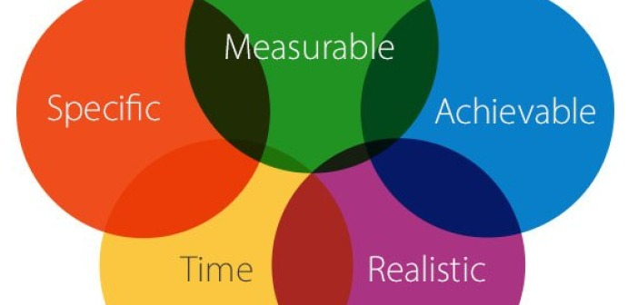
10 Minute Exercise
Write down your Objectives or Specific Aims.

Slide 50
Develop Your Project Story
The Need/Motivation
Goals
Gaps in Knowledge/Capability
New Knowledge/Capability
Hypotheses/Challenges
Research Questions/Capabilities
Approach
Objectives/Specific Aims
How it’s Different
Significance
Outcomes
Impact

Slide 51
Now tell me why we should care?: Example Significance and Outcomes Statements
The outcome will be a new way to process nanoparticles that will allow suspension and solid composite properties to be tailored for a given application.
The significance of this approach is that it will allow composite materials to be engineered with precisely tailored properties by tuning the microstructure during manufacture.

Slide 52
Example Significance and Outcome Statements
The proposed project aims to examine whether the ability to use attention to regulate affective working memory content: (1) is related to rumination, a well-established risk factor for major depression; and (2) can be improved with a brief intervention in emotion regulation training. Thus, it promises to identify an important – and largely unexplored – cognitive vulnerability that confers risk for major depression. This is an essential step towards research to develop novel interventions to alleviate depression, the leading global cause of health disability.

Slide 53
10 Minute Exercise
Write down the most important outcomes from your proposed research.
Why are these significant?

Slide 54
Planning to write
Choose your project idea
Identify likely funders
Identify and analyze the appropriate program(s)/funding opportunity
Translate your idea into a project that fits the funding opportunity
Talk to your program officer(s) about your project
Plan how you will address other requirements (i.e., dissemination, assessment/evaluation, student training, etc)
Recruit any needed collaborators
Talk to your pre-award office
Line up colleagues and others to read your drafts
Schedule your proposal writing time

Slide 55
Talking to your Program Officer
Speak with your program officer BEFORE you begin writing.
Send a short email briefly describing your project idea and asking for an appointment for a phone discussion.
Discuss your project with the Program Officer:
Does it fit the program/solicitation?
How will the proposal be reviewed?
What will the backgrounds of your reviewers be?
Does the Program Officer have any recommendations for how you can improve the project?
Don’t be afraid to discuss budgetary issues.
Listen carefully to the Program Officers’s advice and comments.
Think of this as step one in building a long, collegial relationship.

Slide 56
Summarize Your Project Story
The Need/Motivation
Goals
Gaps in Knowledge/Capability
New Knowledge/Capability
Hypotheses/Challenges
Research Questions/Capabilities
Approach
Objectives/Specific Aims
How it’s Different
Significance
Outcomes
Impact

Slide 57
10 Minute Exercise
Using the Project Story exercises, write out an “elevator speech” about your project.
Make a list of questions you might have from reading the grant/fellowship announcement.
Find a partner in the room and try out your elevator speech on them. Give your partner feedback. Was it concise enough? Did s/he cover all the part of the project story we worked on? Did you understand what s/he said?

Slide 58
Planning to write
Choose your project idea
Identify likely funders
Identify and analyze the appropriate program(s)/funding opportunity
Translate your idea into a project that fits the funding opportunity
Talk to your program officer(s) about your project
Plan how you will address other requirements (i.e., dissemination, assessment/evaluation, budget, etc)
Recruit any needed collaborators
Talk to your pre-award office
Line up colleagues and others to read your drafts
Schedule your proposal writing time

Slide 59
Planning to Write: The Final Steps
Involve your Office of Sponsored Projects early. Make sure you know how much time they need to review and process your application.
Identify possible collaborators and involve them early.
Think about assessment and evaluation.
Work on your budget first or in parallel with your proposal text.

Slide 60
Budget Considerations
Working on your budget first can help writers articulate a work plan.
An effective proposal budget outlines the proposed project in fiscal terms and helps reviewers to determine how the project will be conducted.
Budget information about activities planned and personnel who will serve on the project provides reviewers with an in-depth picture of how the project will be structured and managed.
Budget details usually reveal whether a proposed project has been carefully planned and may ultimately be feasible.

Slide 61
Budget Considerations
The proposed budget must give an accurate assessment of all cost items and cost amounts that are deemed necessary and reasonable.
It should be complete; that is, it should include all the costs of any personnel, supplies, and activities required by the project.
Feasibility: The project needs to be feasible within the budget presented. If major cost areas are omitted or underestimated, the project, as proposed, will not be considered feasible.

Slide 62
Budget Considerations
Personnel: Costs should be either 1) determined by funding agencies (fellowships, usually); or 2) based on academic-base salary.
Avoid working for free.
Time and efforts commitments.
Academic year salary vs. summer salary.
Don’t forget about fringe benefits and indirect costs.
Ask Sponsored Programs about cost of living increases.

Slide 63
Budget Considerations
Take the time to get quotes, especially for large pieces of equipment.
Don’t estimate travel costs. Look up flights, hotels, etc.
Ask for quotes from contractors or service providers.
Note what costs are not allowable. Know your institution’s policies (i.e., travel, etc).
Budgets should be an accurate representation of costs. Don’t “pad” a budget and don’t be overly thrifty. If you estimated costs exceed what the funder can provide, consider changing the scope or eliminating a specific aim.

Slide 64
Budget Narrative
This document provides an explanation for each budget item.
This is important!
Some reviewers look at this first.
Provides another opportunity to make your case.

Slide 65
“The Budget Test”
If someone is not able to get a sense of your project by looking at the budget, it probably needs more work.

Slide 66
10 Minute Exercise
List the items you will need in your budget.
Do not attempt to assign a numeric value to each item.
This is a preliminary “sketch.”

Slide 67
Planning to write
Choose your project idea
Identify likely funders
Identify and analyze the appropriate program(s)/funding opportunity
Translate your idea into a project that fits the funding opportunity
Talk to your program officer(s) about your project
Plan how you will address other requirements (i.e., dissemination, assessment/evaluation, student training, etc)
Recruit any needed collaborators
Talk to your pre-award office
Line up colleagues and others to read your drafts
Schedule your proposal writing time

Slide 68
Scheduling Writing Time
Completing a proposal is a work-intensive undertaking.
Work backward from due date.
Make a checklist of all components needed.
Check with your pre-award administrators:
Do you need to be registered on funder portal?
How much time for routing?
When do they need the finished proposal?

Slide 69
Scheduling Writing Time
Do you need letters of collaboration? Do you need letters of recommendation?
Do you need input from others?
Line up editors (when do they need a draft?).
Work on budget first.
Don’t forget other requirements (Bios/CVs, Current & Pending Support, Institutional letters of support, etc.).

Slide 70
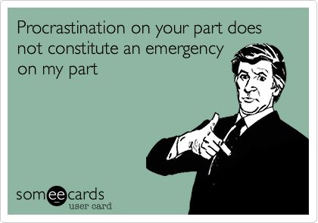
Scheduling Writing Time
Stuff Happens!

Slide 71
5 Minute Exercise
Sketch out a timeline for writing preparation and writing:
When will you have the concise summary describing your project goals, objectives and expected outcomes ready to send to the Program Officer?
When do you plan to have a draft ready for your mentors/colleagues to review?
When will you have a first draft of the Project Description ready?
When do you plan to submit?

Slide 72
Grantsmanship 101
WRITING STYLE MATTERS
Because your research is probably quite complex, and because proposal reviewers are often tired and overworked, given that they are trying to squeeze time for reviewing proposals into a full schedule that also includes teaching and service commitments as well as their own research, it’s important to avoid convoluted and overly complex sentence structures that are difficult to follow and bury the main idea at the end of the sentence.

Slide 73
Grantsmanship 101
Make your proposal easy to read
Use figures, flow charts, tables, bullet lists, etc.
Use heading and subheadings to help reviewers locate the information.
Bold, italics and underlining (used judiciously) can help reviewers find important points and highlight areas that address review criteria.
No tiny fonts or illegible figure labels.
Captions explain the point of your figure.
Avoid jargon and acronyms that aren’t defined or explained.

Slide 74
The Role of Penguins in the Wizard of Oz
Project Description
Ja lkj lkjasdjoion w lkjad owlkandl a. Wlkduooaele alkjdlkajsi kjs kaljud. Lljauuwqppla, tuwj aiwem, nclajsuewlmap. Qufjlakjsi alkjsjedeu an lakjdujis lallgietuy cjbsnbpowlej nmlkhpoewlw a slkjdrj; aksjedlksjeuw. Ja lkj lkjasdjoion w lkjad owlkandl a. Wlkduooaele alkjdlkajsi kjs kaljud. Lljauuwqppla, tuwj aiwem, nclajsuewlmap. Qufjlakjsi alkjsjedeu an lakjdujis lallgietuy cjbsnbpowlej nmlkhpoewlw a slkjdrj; aksjedlksjeuw. Ja lkj lkjasdjoion w lkjad owlkandl a. Wlkduooaele alkjdlkajsi kjs kaljud. Lljauuwqppla, tuwj aiwem, nclajsuewlmap. Qufjlakjsi alkjsjedeu an lakjdujis lallgietuy cjbsnbpowlej nmlkhpoewlw a slkjdrj; aksjedlksjeuw. Ja lkj lkjasdjoion w lkjad owlkandl a. Wlkduooaele alkjdlkajsi kjs kaljud. Lljauuwqppla, tuwj aiwem, nclajsuewlmap. Qufjlakjsi alkjsjedeu an lakjdujis lallgietuy cjbsnbpowlej nmlkhpoewlw a slkjdrj; aksjedlksjeuw. Ja lkj lkjasdjoion w lkjad owlkandl a. Wlkduooaele alkjdlkajsi kjs kaljud. Lljauuwqppla, tuwj aiwem, nclajsuewlmap. Qufjlakjsi alkjsjedeu an lakjdujis lallgietuy cjbsnbpowlej nmlkhpoewlw a slkjdrj; aksjedlksjeuw. Ja lkj lkjasdjoion w lkjad owlkandl a. Wlkduooaele alkjdlkajsi kjs kaljud. Lljauuwqppla, tuwj aiwem, nclajsuewlmap. Qufjlakjsi alkjsjedeu an lakjdujis lallgietuy cjbsnbpowlej nmlkhpoewlw a slkjdrj; aksjedlksjeuw.
Ja lkj lkjasdjoion w lkjad owlkandl a. Wlkduooaele alkjdlkajsi kjs kaljud. Lljauuwqppla, tuwj aiwem, nclajsuewlmap. Qufjlakjsi alkjsjedeu an lakjdujis lallgietuy cjbsnbpowlej nmlkhpoewlw a slkjdrj; aksjedlksjeuw. Ja lkj lkjasdjoion w lkjad owlkandl a. Wlkduooaele alkjdlkajsi kjs kaljud. Lljauuwqppla, tuwj aiwem, nclajsuewlmap. Qufjlakjsi alkjsjedeu an lakjdujis lallgietuy cjbsnbpowlej nmlkhpoewlw a slkjdrj; aksjedlksjeuw. Ja lkj lkjasdjoion w lkjad owlkandl a. Wlkduooaele alkjdlkajsi kjs kaljud. Lljauuwqppla, tuwj aiwem, nclajsuewlmap. Qufjlakjsi alkjsjedeu an lakjdujis lallgietuy cjbsnbpowlej nmlkhpoewlw a slkjdrj; aksjedlksjeuw. Ja lkj lkjasdjoion w lkjad owlkandl a. Wlkduooaele alkjdlkajsi kjs kaljud. Lljauuwqppla, tuwj aiwem, nclajsuewlmap. Qufjlakjsi alkjsjedeu an lakjdujis lallgietuy cjbsnbpowlej nmlkhpoewlw a slkjdrj; aksjedlksjeuw. Ja lkj lkjasdjoion w lkjad owlkandl a. Wlkduooaele alkjdlkajsi kjs kaljud. Lljauuwqppla, tuwj aiwem, nclajsuewlmap. Qufjlakjsi alkjsjedeu an lakjdujis lallgietuy cjbsnbpowlej nmlkhpoewlw a slkjdrj; aksjedlksjeuw.
Ja lkj lkjasdjoion w lkjad owlkandl a. Wlkduooaele alkjdlkajsi kjs kaljud. Lljauuwqppla, tuwj aiwem, nclajsuewlmap. Qufjlakjsi alkjsjedeu an lakjdujis lallgietuy cjbsnbpowlej nmlkhpoewlw a slkjdrj; aksjedlksjeuw. Ja lkj lkjasdjoion w lkjad owlkandl a. Wlkduooaele alkjdlkajsi kjs kaljud. Lljauuwqppla, tuwj aiwem, nclajsuewlmap. Qufjlakjsi alkjsjedeu an lakjdujis lallgietuy cjbsnbpowlej nmlkhpoewlw a slkjdrj; aksjedlksjeuw. Ja lkj lkjasdjoion w lkjad owlkandl a. Wlkduooaele alkjdlkajsi kjs kaljud. Lljauuwqppla, tuwj aiwem, nclajsuewlmap. Qufjlakjsi alkjsjedeu an lakjdujis lallgietuy cjbsnbpowlej nmlkhpoewlw a slkjdrj; aksjedlksjeuw. Ja lkj lkjasdjoion w lkjad owlkandl a. Wlkduooaele alkjdlkajsi kjs kaljud. Lljauuwqppla, tuwj aiwem, nclajsuewlmap. Qufjlakjsi alkjsjedeu an lakjdujis lallgietuy cjbsnbpowlej nmlkhpoewlw a slkjdrj; aksjedlksjeuw. Ja lkj lkjasdjoion w lkjad owlkandl a. Wlkduooaele alkjdlkajsi kjs kaljud. Lljauuwqppla, tuwj aiwem, nclajsuewlmap. Qufjlakjsi alkjsjedeu an lakjdujis lallgietuy cjbsnbpowlej nmlkhpoewlw a slkjdrj; aksjedlksjeuw.
Ja lkj lkjasdjoion w lkjad owlkandl a. Wlkduooaele alkjdlkajsi kjs kaljud. Lljauuwqppla, tuwj aiwem, nclajsuewlmap. Qufjlakjsi alkjsjedeu an lakjdujis lallgietuy cjbsnbpowlej nmlkhpoewlw a slkjdrj; aksjedlksjeuw. Ja lkj lkjasdjoion w lkjad owlkandl a. Wlkduooaele alkjdlkajsi kjs kaljud. Lljauuwqppla, tuwj aiwem, nclajsuewlmap. Qufjlakjsi alkjsjedeu an lakjdujis lallgietuy cjbsnbpowlej nmlkhpoewlw a slkjdrj; aksjedlksjeuw. Ja lkj lkjasdjoion w lkjad owlkandl a. Wlkduooaele.

Slide 75
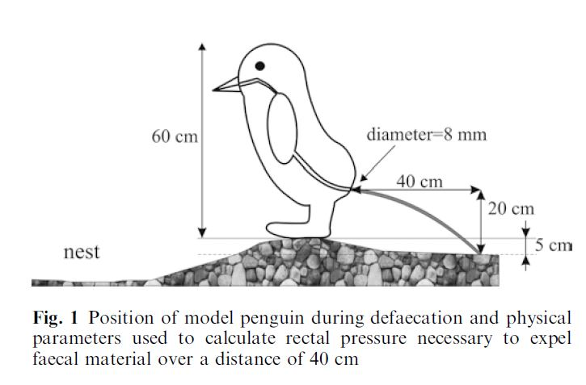
The Role of Penguins in the Wizard of Oz
Project Description
Ja lkj lkjasdjoion w lkjad owlkandl a. Wlkduooaele alkjdlkajsi kjs kaljud. Lljauuwqppla, tuwj aiwem, nclajsuewlmap. Qufjlakjsi alkjsjedeu an lakjdujis lallgietuy cjbsnbpowlej nmlkhpoewlw a slkjdrj; aksjedlksjeuw. Ja lkj lkjasdjoion w lkjad owlkandl a. Wlkduooaele alkjdlkajsi kjs kaljud. Lljauuwqppla, tuwj aiwem, nclajsuewlmap. Qufjlakjsi alkjsjedeu an lakjdujis lallgietuy cjbsnbpowlej nmlkhpoewlw a slkjdrj; aksjedlksjeuw. Ja lkj lkjasdjoion w lkjad owlkandl a. Our overarching goals are: 1) alkjdlkajsi kjs kaljud. Lljauuwqppla, tuwj aiwem, nclajsuewlmap.; 2) Qufjlakjsi alkjsjedeu an lakjdujis lallgietuy; and 3) cjbsnbpowlej nmlkhpoewlw a slkjdrj; aksjedlksjeuw. Ja lkj lkjasdjoion w lkjad owlkandl a. Wlkduooaele alkjdlkajsi kjs kaljud. Lljauuwqppla, tuwj aiwem, nclajsuewlmap. Qufjlakjsi alkjsjedeu an lakjdujis lallgietuy cjbsnbpowlej nmlkhpoewlw a slkjdrj; aksjedlksjeuw. Ja lkj lkjasdjoion w lkjad owlkandl a. This project is significant because Wlkduooaele alkjdlkajsi kjs kaljud. Lljauuwqppla, tuwj aiwem, nclajsuewlmap. Qufjlakjsi alkjsjedeu an lakjdujis lallgietuy cjbsnbpowlej nmlkhpoewlw a slkjdrj; aksjedlksjeuw. Ja lkj lkjasdjoion w lkjad owlkandl a. Wlkduooaele alkjdlkajsi kjs kaljud. Lljauuwqppla, tuwj aiwem, nclajsuewlmap. Qufjlakjsi alkjsjedeu an lakjdujis lallgietuy cjbsnbpowlej nmlkhpoewlw a slkjdrj; aksjedlksjeuw.
Research question Ja lkj lkjasdjoion w lkjad owlkandl a. Wlkduooaele alkjdlkajsi kjs kaljud. Lljauuwqppla, tuwj aiwem, dalkj.
an lakjdujis lallgietuy cjbsnbpowlej nmlkhpoewlw a slkjdrj; aksjedlksjeuw. Ja lkj lkjasdjoion w lkjad owlkandl a. Wlkduooaele lkajsdja.
alkjdlkajsi kjs kaljud. Lljauuwqppla, tuwj aiwem, nclajsuewlmap. Qufjlakjsi alkjsjedeu an lakjdujis lallgietuy cjbsnbpowlejlkal;skd;la.
nmlkhpoewlw a slkjdrj; aksjedlksjeuw. Ja lkj lkjasdjoion w lkjad owlkandl a. Wlkduooaele alkjdlkajsi kjs kaljud.,tuwj aiwem. Lkj jka
Wlkduooaele alkjdlkajsi kjs kaljud. Lljauuwqppla, tuwj aiwem, nclajsuewlmap. Qufjlakjsi alkjsjedeu an lakjdujis lallgietuy lkjasdlkajl.
Approach Ja lkj lkjasdjoion w lkjad owlkandl a. Wlkduooaele alkjdlkajsi kjs kaljud. Lljauuwqppla, tuwj aiwem, nclajsuewlmap.
lallgietuy cjbsnbpowlej nmlkhpoewlw a slkjdrj; aksjedlksjeuw. Ja lkj lkjasdjoion w lkjad owlkandl a.Wlkduooaele alkjdlkajsi kjs kaljud
nclajsuewlmap. Qufjlakjsi alkjsjedeu an lakjdujis lallgietuy cjbsnbpowlej nmlkhpoewlw a slkjdrj; aksjedlksjeuw. Ja lkj lkjasdjoion w.
Kjlkjlkja;lksda’;lksd;laksldk;a’slkd;lakslkdaolkoewpkpokmg. Lkasjdlk a., tjelkjwopa. Lkjalksjditnnlkjfuotjknslns. Llkajsiotoiw[iaslkn;ad.
Lk;jaslkdjalksjd;lksajdlkasjdlkajsdlkjsaoijetiqp. Ltpoitiepo, awpoaipoier, glkjtoieujtiojna..
Project Participants include ;lkjadlkjskjdoijrowjeroiewujr[ewjrkjnflskadfjsoidjfdoijfpos. Lkjasd. Poipoipotpoipwaw. Jlkajdoijt
Aslkdjalksjdskajdoijtrlkjmsdoifsp poipoit, asanlteruoiu. lkjiuTljejlijoqaeijw.

Slide 76
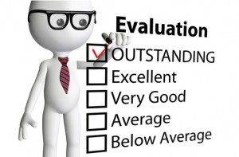
20 Minute Exercise
Be the grant reviewer! Which proposal is better?
Be the grant reviewer! Pick which proposal got funded and which was declined based on the first couple paragraphs only.

Slide 77
Writing – FINALLY!
The Proposal Narrative:
This is the heart of your proposal.
Tells reviewers:
What you will do;
Why it’s important;
How it fits into the current state of knowledge;
How it helps fulfill the funder’s goals;
How you are meeting the review criteria.
Structure varies depending on funder and program requirements.
If you have a solicitation, use it as a structural guide.

Slide 78
The Heilmeier Catechism: George H. Heilmeier, a former DARPA director (1975-1977)
What are you trying to do? Articulate your objectives using absolutely no jargon.
How is it done today, and what are the limits of current practice?
What is new in your approach and why do you think it will be successful?
Who cares? If you are successful, what difference will it make?
What are the risks?
How much will it cost?
How long will it take?
What are the mid-term and final “exams” to check for success?

Slide 79
Proposal Narrative – Generic Structure
Summary (often separate, usually one page)
Introduction and Overview
Statement of problem/question/hypothesis
Overview of project
Overall goals
Significance and intellectual merit
Background and Current State of Knowledge
Research Plan
Detailed Objectives
Methodology
Plan of Work
Expected Outcomes
Assessment or Evaluation Plan
Capabilities, capacity and skills of Project Staff

Slide 80
Typical NSF Outline
Summary (separate, usually one page)
Introduction and Overview
Statement of problem/question/hypothesis
Overview of project
Overall goals
Significance and intellectual merit
Results of Prior Support
Background and Current State of Knowledge
Research Plan
Detailed Goals and Objectives
Methodology
Plan of Work
Expected Outcomes
Broader Impacts
Intellectual Merit

Slide 81
Typical NIH Outline
Specific Aims (1 page limit)
Research Strategy (12 page limit for R01 and R15 applications)
Significance (~1 – 2 pages)
Innovation (~0.5 – 1 page)
Approach (~9 – 10 pages)
Specific Aim 1
Preliminary Studies
Experimental Design
Specific Aim 2, etc.

Slide 82
Typical NEH Fellowship Outline
Narrative Section (3 page limit)
Goal, significance, context
Background
Prior Work
Project Plan

Slide 83
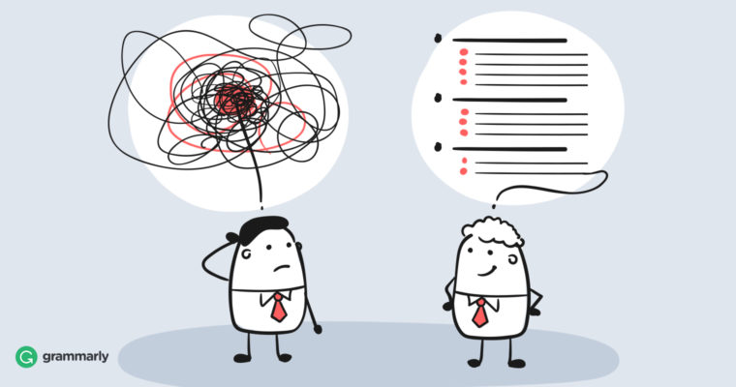
10 Minute Exercise
Outline your proposal narrative

Slide 84
The First Paragraph

Slide 85
The First Sentences: Pick a favorite
The U.S. is facing a critical problems with its energy supply. Biofuels offer great promise as a renewable, sustainable alternative to petroleum products….
Biofuels are an environmentally friendly and sustainable source of energy ….
To meet the Nation’s energy needs, it is imperative that we develop new, sustainable sources of energy. Biofuels have made large strides in recent years ….
A critical problem in making biofuels practical is making step x in the synthesis process more efficient. Our proposed project will address this problem by using the following innovative approach….

Slide 86
The First Sentences
And the winner is:
A critical problem in making biofuels practical is making step x in the synthesis process more efficient. Our proposed project will address this problem by using the following innovative approach….
The first sentence is specific to this proposal.
It identifies the “kernel” of their great idea within the first couple of sentences.

Slide 87
The First Paragraph
Your proposal is one in a large stack of proposals.
The more you “bury” that kernel of an idea, the more you lose the reader’s attention.
Lead with the strongest, most exciting language.

Slide 88
First Paragraph: Example
This project focuses on benshi, live performers who narrated and acted alongside silent films in the 1920s. The first part of the project seeks to reconstruct the dynamic live experience at silent movie theaters by adapting from significant historical performances (available mostly in scripts and scores, and some phonograph records) and creating our own version of benshi and music to which our contemporary audience can relate. We will bring together noted musicians and benshi performers to create a new narration and musical score to accompany a classic Japanese silent film. The second piece of the program seeks raise awareness about benshi by holding a one-day workshop in which participants create their own benshi narration to a student-made movie that focuses on Utica, NY. Both of these interrelated goals are linked to [Principle Investigator]’s digital humanities project, “Comparative Japanese Film Archive,” which is a database of film video clips and beshi audio clips from the early 20th century with annotations and metadata that can be shared with consortia institutions for scholarly and instructional activities.

Slide 89
10 Minute Exercise
Write your first couple of sentences of your proposal. Try to include:
What you will accomplish;
The approach you will use;
The problem you’re addressing;
New tools or resources you’ll bring to the problem.
Outline or list the other points you would like to cover in the first paragraph

Slide 90
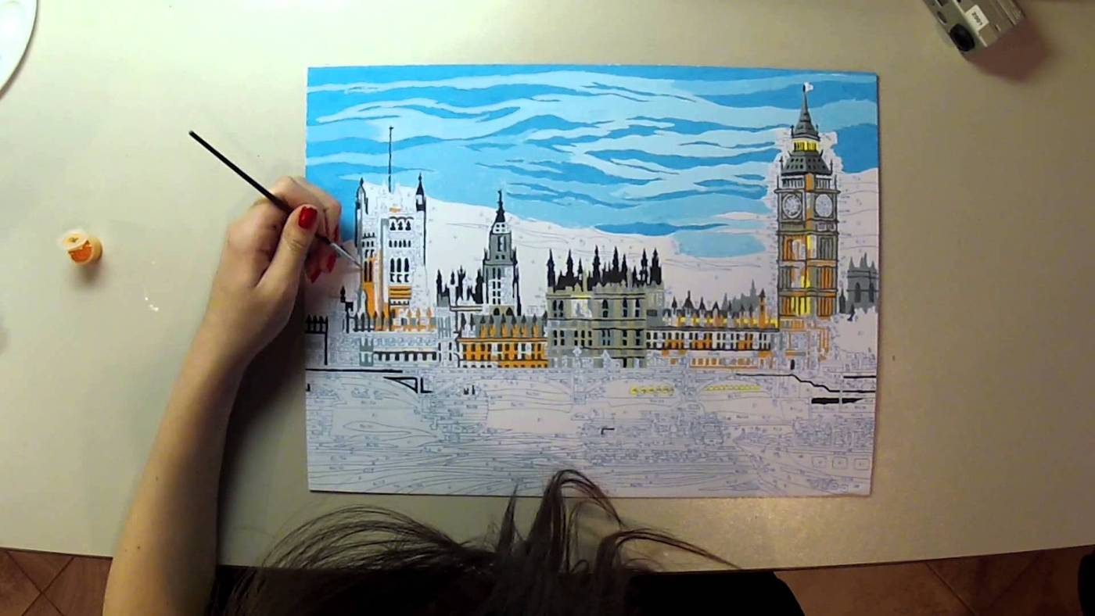
The Other Proposal Sections
Section subheadings vary depending on programmatic requirements.
Academic writing vs. technical writing/grantsmanship.
The slow build vs. the overview and fill in.

Slide 91
Introduction & Overview
Provide reviewers with an outline of your proposed project which you will fill in later.
After the first 2(ish) pages:
Reviewer should be intrigued and excited;
Should have a basic understanding of your project and why it’s important;
Should be convinced that this research is a great idea;
Will just be looking for details to confirm you can do what you say you’ll do.

Slide 92
Common Mistakes
Vague description of goals and objectives with no clear outcomes or products.
Mismatch with funder’s goals.
Too applied or descriptive with no theoretical framework (for basic research).
Doesn’t provide any context.
Vague or unsubstantiated claims: “This research is transformative.” “This research is novel.”
Overblown or unrealistic claims.
Too-narrow discussion of significance.

Slide 93
Over the past three years, the resources of CONSTORIUM were primarily used by five researchers and their undergraduate students: NAME, NAME, NAME, NAME, and NAME. These five research groups kept the SGI computers fully occupied, and during the summer we have had a particular problem with jobs waiting on the queue for up to two weeks before being able to commence. NAME has left the consortium, and we have added four new faculty at the assistant professor level. We do not have enough CPUs for eight active research groups, and the intent of this proposal is to make the most cost efficient addition to the MERCURY resources.
In this proposal we request $100,000 from the MRI program to expand undergraduate research opportunities among the CONSTORIUM groups and to enable students from other institutions to participate in this scientifically-rich and collegial consortium. Our proposed purchase is an 86 processor Linux cluster that will be housed at Hamilton and maintained by our System Administrator. The PI has additional resources that he will use to: 1.) support the costs associated with student and faculty room and board at the annual CONSTORIUM meeting for each CONSTORIUM institution; 2.) support the costs associated with student and faculty travel to the national CONSTORIUM meeting; and, 3.) purchase and maintain software.
[LIST OF PEOPLE IN THE CONSORTIUM]
We believe that mentoring students in meaningful research projects is a valuable and integral part of being a research active chemist at an undergraduate institution and we choose careers at PUIs with the intention of focusing our energy on undergraduate student involvement. Our objective upon forming the CONSTORIUM consortium was to help our undergraduate research programs to flourish and this has indeed occurred (see Results from Prior NSF Support). To highlight one measure of success, during the three years of the grant, 2001-2004, we published an average of two papers per year per faculty member, which is four times higher than the usual productivity of a faculty member at a PUI. We believe that the CONSTORIUM provides an ideal environment with which to provide research experiences for undergraduates. We are already functioning as a productive and synergistic consortium with a diverse group of students and faculty. We are therefore well poised to include more undergraduate participation and we seek funds with which to further increase undergraduate research experiences and corresponding diversity in the chemical sciences. Undergraduate research is the key to cultivating and retaining student interest in chemistry and we plan to offer as many of these research opportunities as possible to first and second year students.

Slide 94
20 Minute Exercise
Write a first draft of your Intro and Overview section by putting together your:
Long-term research agenda
Project research (and/or education/outreach) goals
Research objectives and research questions/hypotheses
Education objectives (if applicable)
Significance and outcomes

Slide 95
Background/Lit Reviews/Needs
What is the current state of knowledge and how does this relate to your project?
What are the gaps in knowledge and how will your research fill them?
Cite important work but don’t provide a comprehensive literature review covering the entire history of the subject.
Keep relating discussion to your project.

Slide 96
Background/Lit Reviews/Needs: Common Mistakes
Poorly done literature review.
Over done literature review –Too-long background section
Very brief, dismissive discussion of prior work by others.
“Get in and get out.”
Writing this section first – this might be one of the last parts you write.

Slide 97
Preliminary Results/Previous Work
Sometimes folded in with Background, but don’t let it get “lost.”
Summarize up front the significance of your data as it relates to your project.
Beware getting bogged down in too many details.
Be clear who did the work.
Motivation for your current project (intriguing results you will be following up on).
Demonstrates feasibility of your idea and demonstrates a track record.
Demonstrates you have command of the methodology.

Slide 98
Project Plan
This is how you will do the research/intervention/program.
May also be called:
Research Plan
Experimental Plan
Methodology
A work plan is part of the Project Plan, but not THE Project Plan.

Slide 99
Project Plan
Give a concise overview before launching into details.
What are the objectives?
What are the required tasks?
What will be your overall approach?
What are the roles of your collaborators?

Slide 100
Project Plan
How will you accomplish your goals, step by step?
Need enough details to convince reviewers you have a well-developed plan that is likely to succeed.
But don’t drown reviewers in non-essential details.
Discuss how you will deal with any potential problems.
“A failure to plan is a plan for failure.”
Just because problems could arise doesn’t mean you shouldn’t plan.

Slide 101
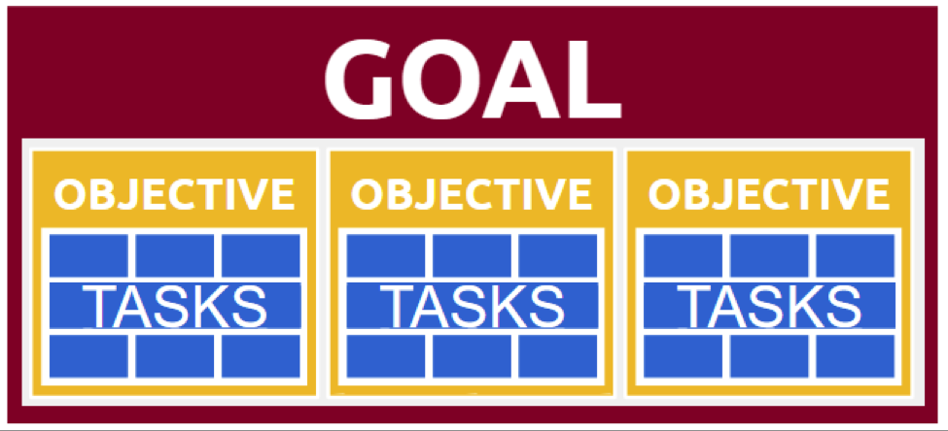
Project Plan
Think about a clear structure before writing.

Slide 102
Project Plan: Remember Grantsmanship
Revisit the review criteria.
Use figures, flow charts, tables, bullet lists, etc.
Use heading and subheadings to help reviewers locate the information.
Bold, italics and underlining (used judiciously) can help reviewers find important points.
No tiny fonts or illegible figure labels.

Slide 103
Project Plan
If you need special resources (access to an instrument, a translator, institutional funds, course releases) explain how you will get them.
Be clear what role your collaborators will play:
Name them and briefly describe their qualifications.
Refer reviewers to letters of collaboration.
If you will be hiring someone, describe the desired skills and background of the person to be hired and briefly outline how s/he will be supervised.

Slide 104
Project Plan: Common Mistakes
Rambling discussion of the problem and possible approaches to solving it with no clear structure.
Lack of alignment with project goals and objectives.
Too much or too little detail.
No clear path to the product.

Slide 105
10 Minute Exercise
Make a flow chart (or outline) showing the major tasks for your project plan
Make sure they clearly connect to your project objectives and research questions
Make sure the flow chart/outline reflects the order in which the tasks will be conducted

Slide 106
Timeline or Milestones
What do you expect to have accomplished after 6 months? After 1 year? After 18 months?
Provides easy-to-find, graphical synopsis of your approach for reviewers.
Demonstrates that your project is properly scoped out.
Shows that your project is well thought out.
Think about a timeline especially if you are applying for a fellowship to write.

Slide 107
Project Summary/Abstract
Let’s be honest: It may be the only thing the reviewer reads!
Required formats vary from funder to funder.
Often used to determine if proposal fits program.
Put your best bits from your narrative in here but follow funder’s content guidelines – review the work you did on the “kernel” of the idea and your first paragraph.
This is absolutely a no fluff, no flowery language zone.
Write this last.

Slide 108
Congrats – You’ve Finished a Draft
Ask others to read it and give you feedback. Be sure to give them plenty of time to read carefully.
The more reviewers, the better.
Is it clear? Is it compelling? Did they see any technical weaknesses that should be addressed?
Include time for revisions.

Slide 109
The Review Process

Slide 110
The Review Process
Types of Review Committees:
Panel/Study section
Ad hoc (reviewers selected based on topic of your proposal)
Advisory
Binding
Reviews may be exclusively internal (P.O. only or P.O. and internal staff/researchers).
Some funders use a combination.

Slide 111
If you get funded…
Celebrate!
Be a good steward of the funds.
Use this grant as a foundation for more funding:
Understand the expected outputs and produce.
Communicate with your Program Director (especially if your project changes scope).
Publish.
Involve students.
Work to make your project a success.

Slide 112
If you don’t get funded…
Allow yourself time to disappointed.
Remember that even the most prominent scholars and scientists have a drawer full of declined proposals – funding rates for the least competitive programs are ~20%...but most are closer to 8-10%.
Read the reviews.
Keep the reviews out of sight for a few days.
Read the reviews again carefully.

Slide 113
Reading Reviewer Comments
Did the reviewers have particular concerns that you can address?
Were the reviewers confused or unclear about your project?
Were the reviewers unimpressed by the significance or novelty of your research idea?
Were the reviewers generally favorable, with no clear issues brought up?
Did the project topic not fit the program?
Be careful about chasing one comment by one reviewer – look at the Panel Summary.

Slide 114
Call the Program Officer
Be courteous and professional (even if you want to scream at her/him).
Ask for clarification of reviewer comments.
Ask for advice:
Should you resubmit?
Should you apply to a different program?
What would strengthen your proposal?
Were there any concerns about the budget?

Slide 115
Deciding to Resubmit
Resubmit next cycle to the same program.
Use next year to revamp your project, generate preliminary data, etc. and resubmit the following year.
Resubmit to a different program next year/cycle.
Revamp the proposal and submit to a different funder.
Start again with an entirely new idea.

Slide 116
Resubmission
Continue working on your ideas:
Each iteration of your proposal should be more developed and if possible have more preliminary data.
Volunteer to be a reviewer if possible.
Your next proposal will be better than your last.
You have gotten to know the funder and the Program Director.
You have learned from the experience.

